Slide 1
SELLING SIMPLY
TO
YOUR EMPLOYEES

Slide 2
Employee sales before…
two rounds
juggling with e-mails and tables
crunching availability figures
creating pick lists and handover lists
queues in the second round

Slide 3
Experience simplicity
only one round, selling out
seamless process, no mistakes
elegant solution
fairness built in (fair distribution, no insider preferences)
important process savings

Slide 4
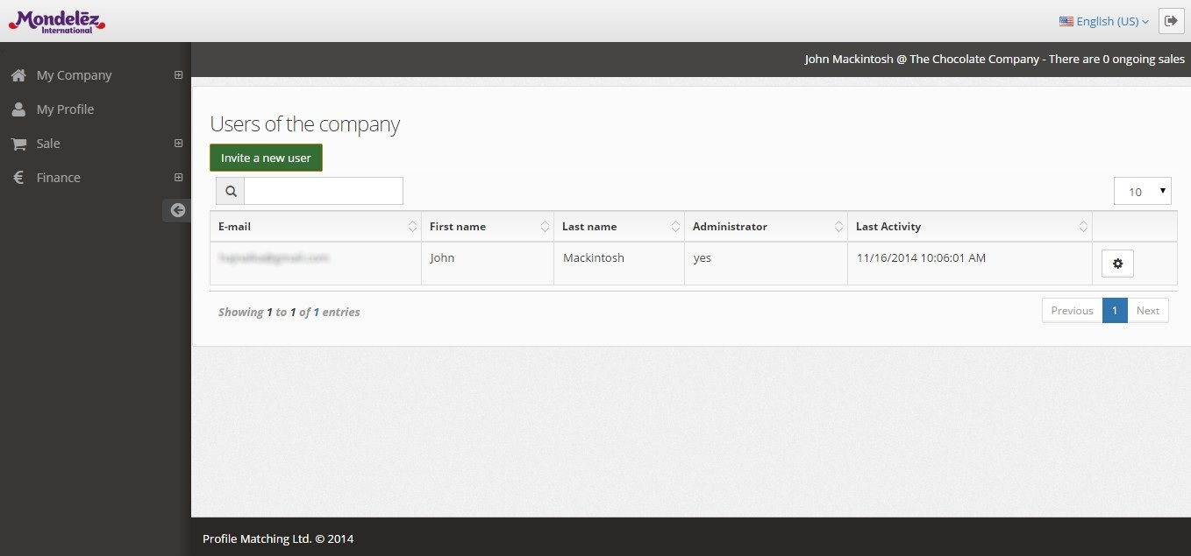
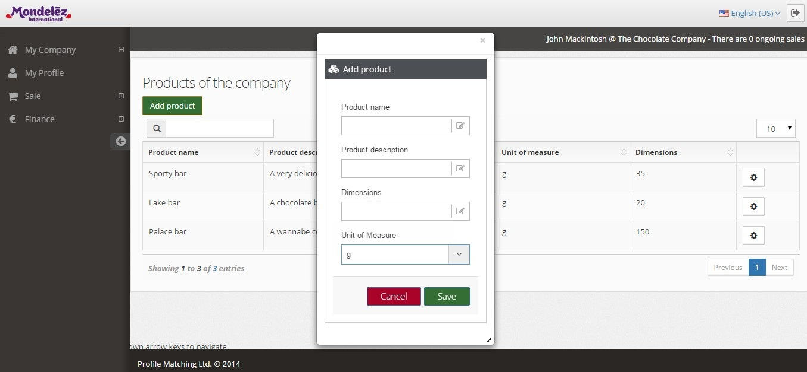
Experience simplicity

Slide 5
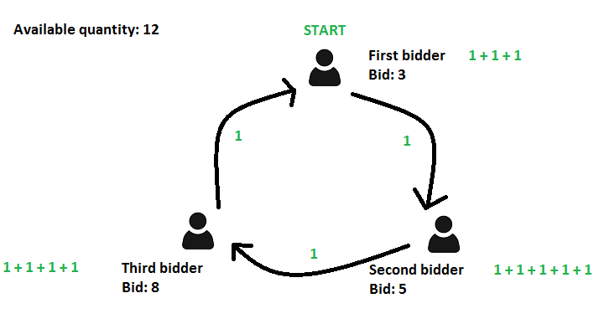
Application logic
“card allocation”combined with “first come, first served” rule
(additional rules can be applied)
Round | First bidder | Second bidder | Third bidder
1 | Gets 1 | Gets 1 | Gets 1
2 | Gets 1 | Gets 1 | Gets 1
3 | Gets 1 Done | Gets 1 | Gets 1
4 |  | Gets 1 | Gets 1
5 |  | Gets 1 Done | No more left
Result | 3 | 5 | 4

Slide 6
Pricing
99 EUR per month per site
unlimited number of sales per site
unlimited number of participants per site and sale

Slide 7
Get in touch
See you soon on Sell2Staff!
Questions, suggestions?
contact@sell2staff.com
Profile Matching Ltd., 207 Regent Street, W1B 3HH London, United Kingdom
--- Selling simply to your employees ---
www.sell2staff.com

